Slide 1
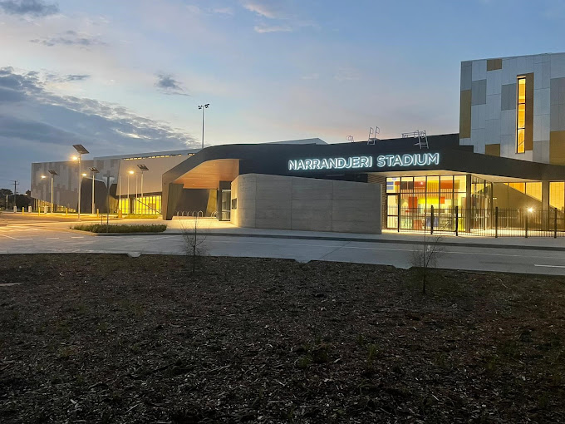
Darebin Netball Association Strategic Plan
2023 to 2026

Slide 2
Our purpose Our purpose We exist to create an environment that focus’ on fun, fitness and inclusion. Agenda

Slide 3
Our purpose Our Vision Darebin Netball Association (DNA) through best practice and governance encourages participation in all aspects of netball including playing (domestic and representative), umpiring, coaching, volunteering, administration and organisation. Agenda

Slide 4
Our Values Inclusion Fun, fitness and well-being Teamwork Fairness Integrity Skill development

Slide 5
Overview DNA aims to bring a community together to enjoy a shared love for netball. Promote leadership and talent development through various avenues including umpiring, coaching, committee engagement and tournament organisation.

Slide 6
Darebin Netball Association History at a glance
In 1972 Preston Netball Association was established.
Today, Darebin Netball continues to grow and flourish and everyone is enjoying the new amenities.
Let's see where the next chapter takes us.
During the next 24 years Preston Netball Association conducted its competition at the outdoor courts at Leamington St Reservoir.
In 1996, Preston and Northcote City Councils amalgamated and consequently Preston Netball Association changed its name and branding to Darebin Netball Association.
In 1996, a new 4 court undercover brand-new facility situated on Plenty Road Reservoir was completed and as a result the newly formed Darebin Netball Association relocated from Leamington Street to Plenty Road Reservoir where it continued to grow until 2022.
In 2022, Darebin once again embarked on a brand-new journey moving to the brand-new state of the art facility Narrandjeri Stadium on Darebin Road Thornbury

Slide 7
The Business
Total Number of playing Members | 900
Number of Committee Members | 9
Member Clubs | Alphington, Angels, Fawkner, Lakeside, Northern Parx, Parklands, Parkside
Committee Function | Oversees governance, policies, financial management and make decisions in the interests of the association, with the power to delegate to functionaries and sub-committees who report back to the committee.
Administration Function | Provides day to day management of the business in regular tasks and in Committee-directed activity.
Competition Structure | Saturday Domestic ( NetSetGo and competition 9U, 11U, 13U 15U, 17U, 18U & Open Age) Wednesday Night Domestic (open Age Female and Mixed) Representative Teams Program: 11/Under, 13/under, 15/under 17/under, Open Age Annual Sunday Tournament Male Representative Team – Men’s League
Council Affiliate | City of Darebin
Club Website | Darebinnetball.com.au
Association Communications | Email, Facebook, Website,

Slide 8
Darebin Netball Association
President
Vice
President
Treasurer
Secretary
Voting Member
Voting Member
Voting Member
Voting Member
Overall Competition Liaison
Rep Liaison
Overseeing
Competition
Fixtures
Umpire coordinator
Sub-Committees
Wednesday night competition
Umpire tester
mentor
DNA finances
DNA administration
Child Safety sub committee
Wednesday night competition
Umpire coordinator
Maintenance of Darebin documents and legal aspects

Slide 9
Strategic Priorities Summary
Participation and Community Development
Develop entry points into netball providing more choice for more sectors of the community.
Develop player participation, competition and performance pathways opportunity.
Develop non-player participation and performance pathway opportunity.
Active communication with multicultural communities to introduce and promote inclusion.
Promote our facilities and amenities.
Good Governance
Continue to develop, refine and implement governance essentials.
Update fundamental Association documents.
Implement a sustainable management structure.
Secure the knowledge and intellectual property of key processes held by long-standing committee members.
Succession planning for future of DNA

Slide 10
Strategic Priorities Summary
Strategic Communications
Strategic and consistent expression of the DNA brand.
Develop and implement marketing and communication strategy.
Business Model
Develop a sustainable business model for DNA.
Develop the key management/administrative roles to support the committee and Association into the future.
Continue to develop revenue streams.
High Performance
Work with our pathway partners to develop players & coaches.
Aim to present a variety of training skills guest coaches, senior player-led training.
Identify, develop & prepare athletes for high performance pathway.
Achieve success for our representative teams.
Increase pathway opportunities for umpires & coaches.
Leadership by respect, example and integrity at all times.

Slide 11
Strategic Priorities Summary
Participation and Development
Increase participation across all facets of player engagement whilst investigating other possibilities around competitions.
Attract & retain new and current participants.
Create new ways for people to enjoy netball, e.g. Fast 5, Walking Netball
Identify opportunities for different streams of participation, e.g. social and competitive.
Development of coaches, umpires, players and committees.
Promote learning opportunities through mentoring, course attendance, practical training and in gaining onfield experience.
Aim for a mix of age, experience, youth, maturity, gender, skill and talent spread across all areas of coaching, umpiring and committee engagement.

Slide 12
Strategic Priorities Summary
Governance and Management
Grow a strong association with skilled volunteers.
Foster a pleasant, co-operative working environment built on trust and integrity for the common benefit of the entire netball community.
Develop plans to retain intellectual capital within the Association.
Develop strong succession planning pathways.
2. Provide sound strategies, financial management & governance.
Regular review of the association’s policies and procedures to ensure best practice in line with parent organization and legal requirements.
3. Committee Members and Sub-Committees to share the workload.
Revenue, Sponsorship, Grants and Marketing
Ensure revenue streams are regularly visited, aiming to improve the Association’s ability to fund and plan for the future.

Slide 13
Darebin Netball Association what success will look like
Life long love of netball.
Safe and compliant facilities for training and competitions to promote community needs and enabling growth.
Increased involvement of players, participants, officials and volunteers.
Members moving into high performance pathways.
Financial stability and reinvestment back into our netball community.
Achievement of success for our Representative program.

